Slide 1

LMU-TUM Joint Meeting 9 August
Hongyi Su (LMU)

Slide 2
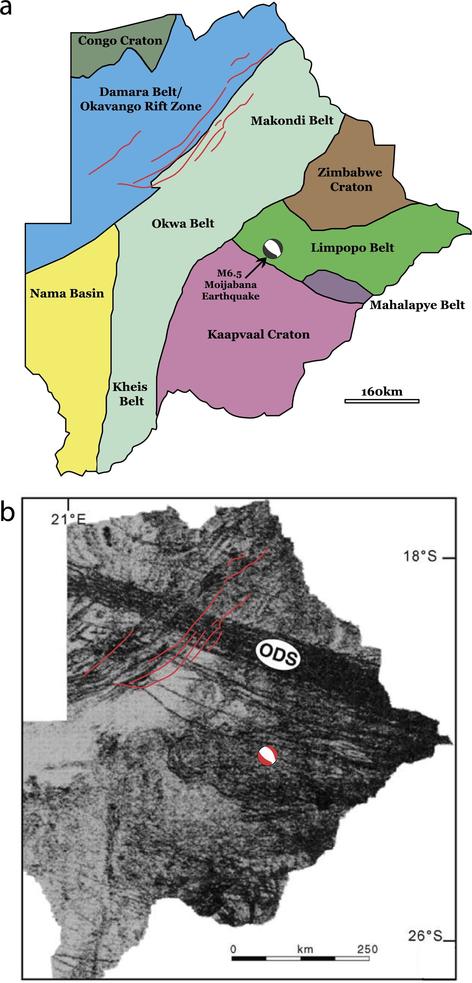
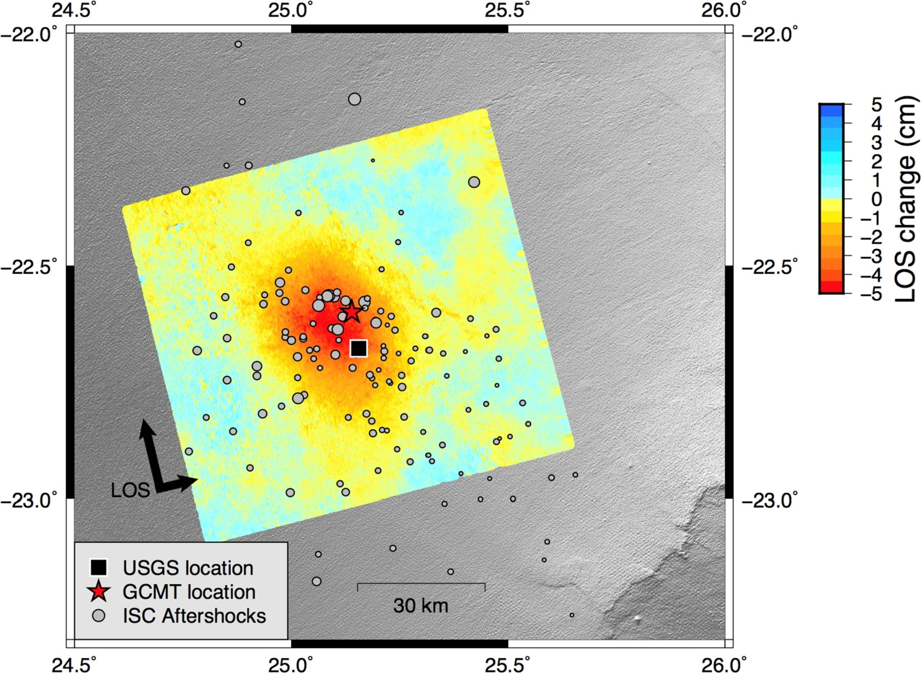
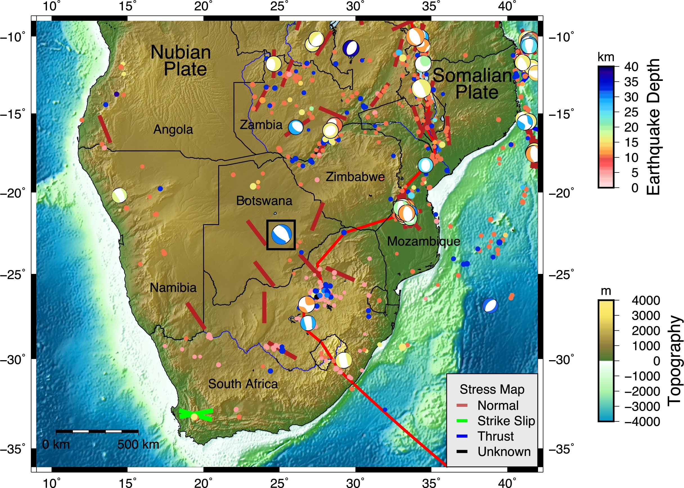
Botswana M6.4 intraplate earthquake
1. Deep – 29-34 km, rare
2. Intraplate – extension focal mechanism, rare
3. large, Mw 6.5 (USGS), M 6.4 (UC Berkeley), rare
Materna et al. 2019
Notes:
Moho discontinuity is about 45 km

Slide 3
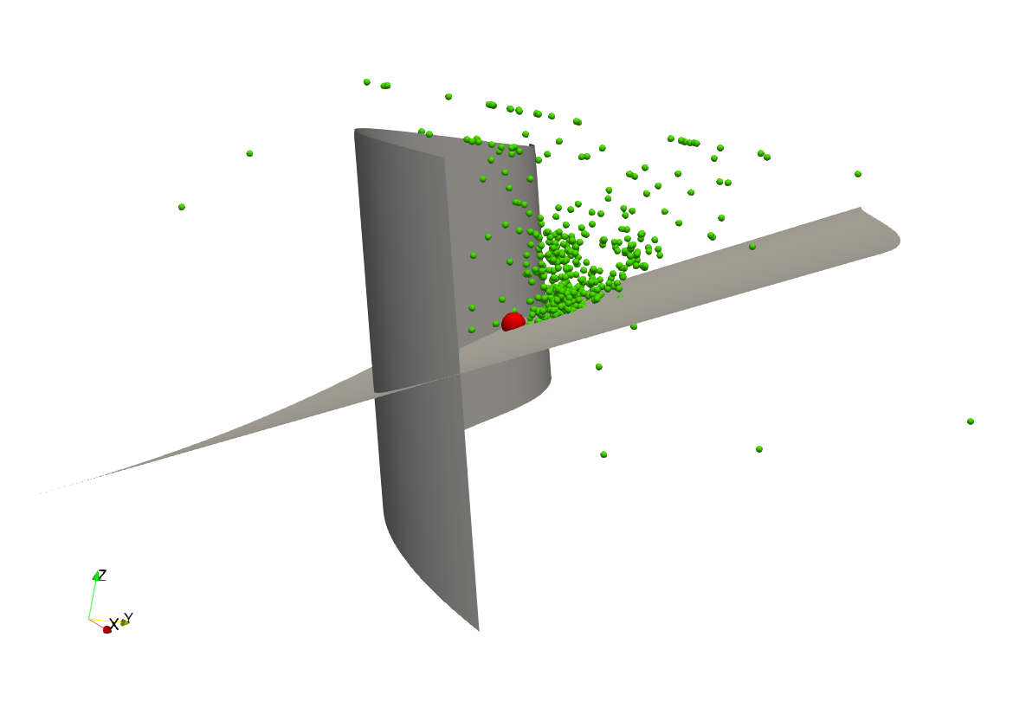
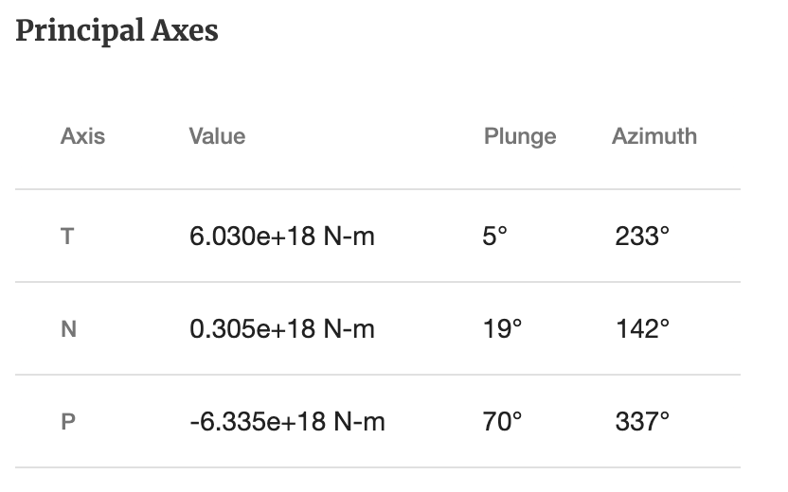
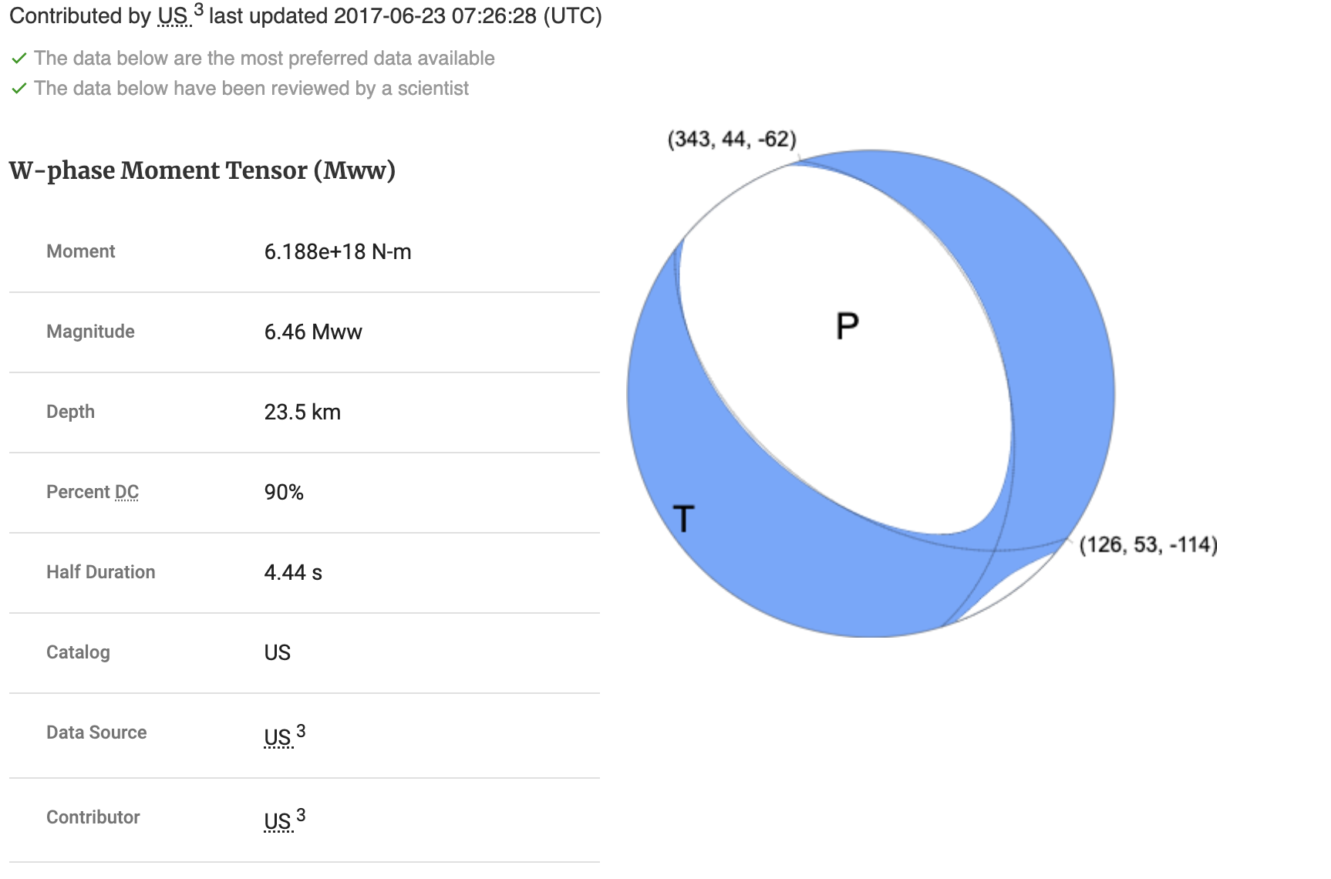
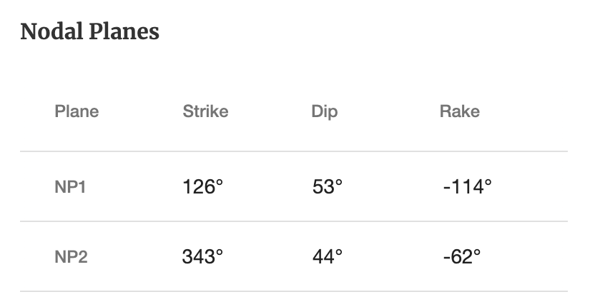
Fault

Slide 4
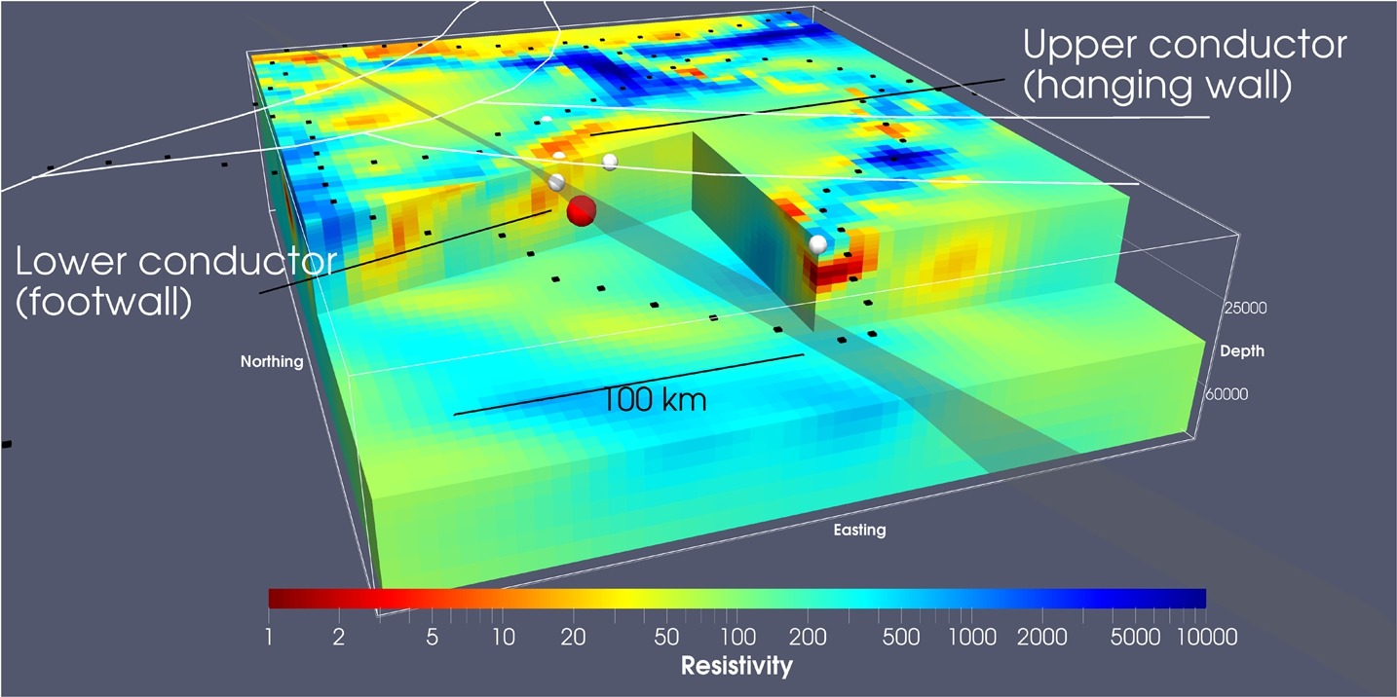
MT methods mapped faults (Moorkamp)

Slide 5
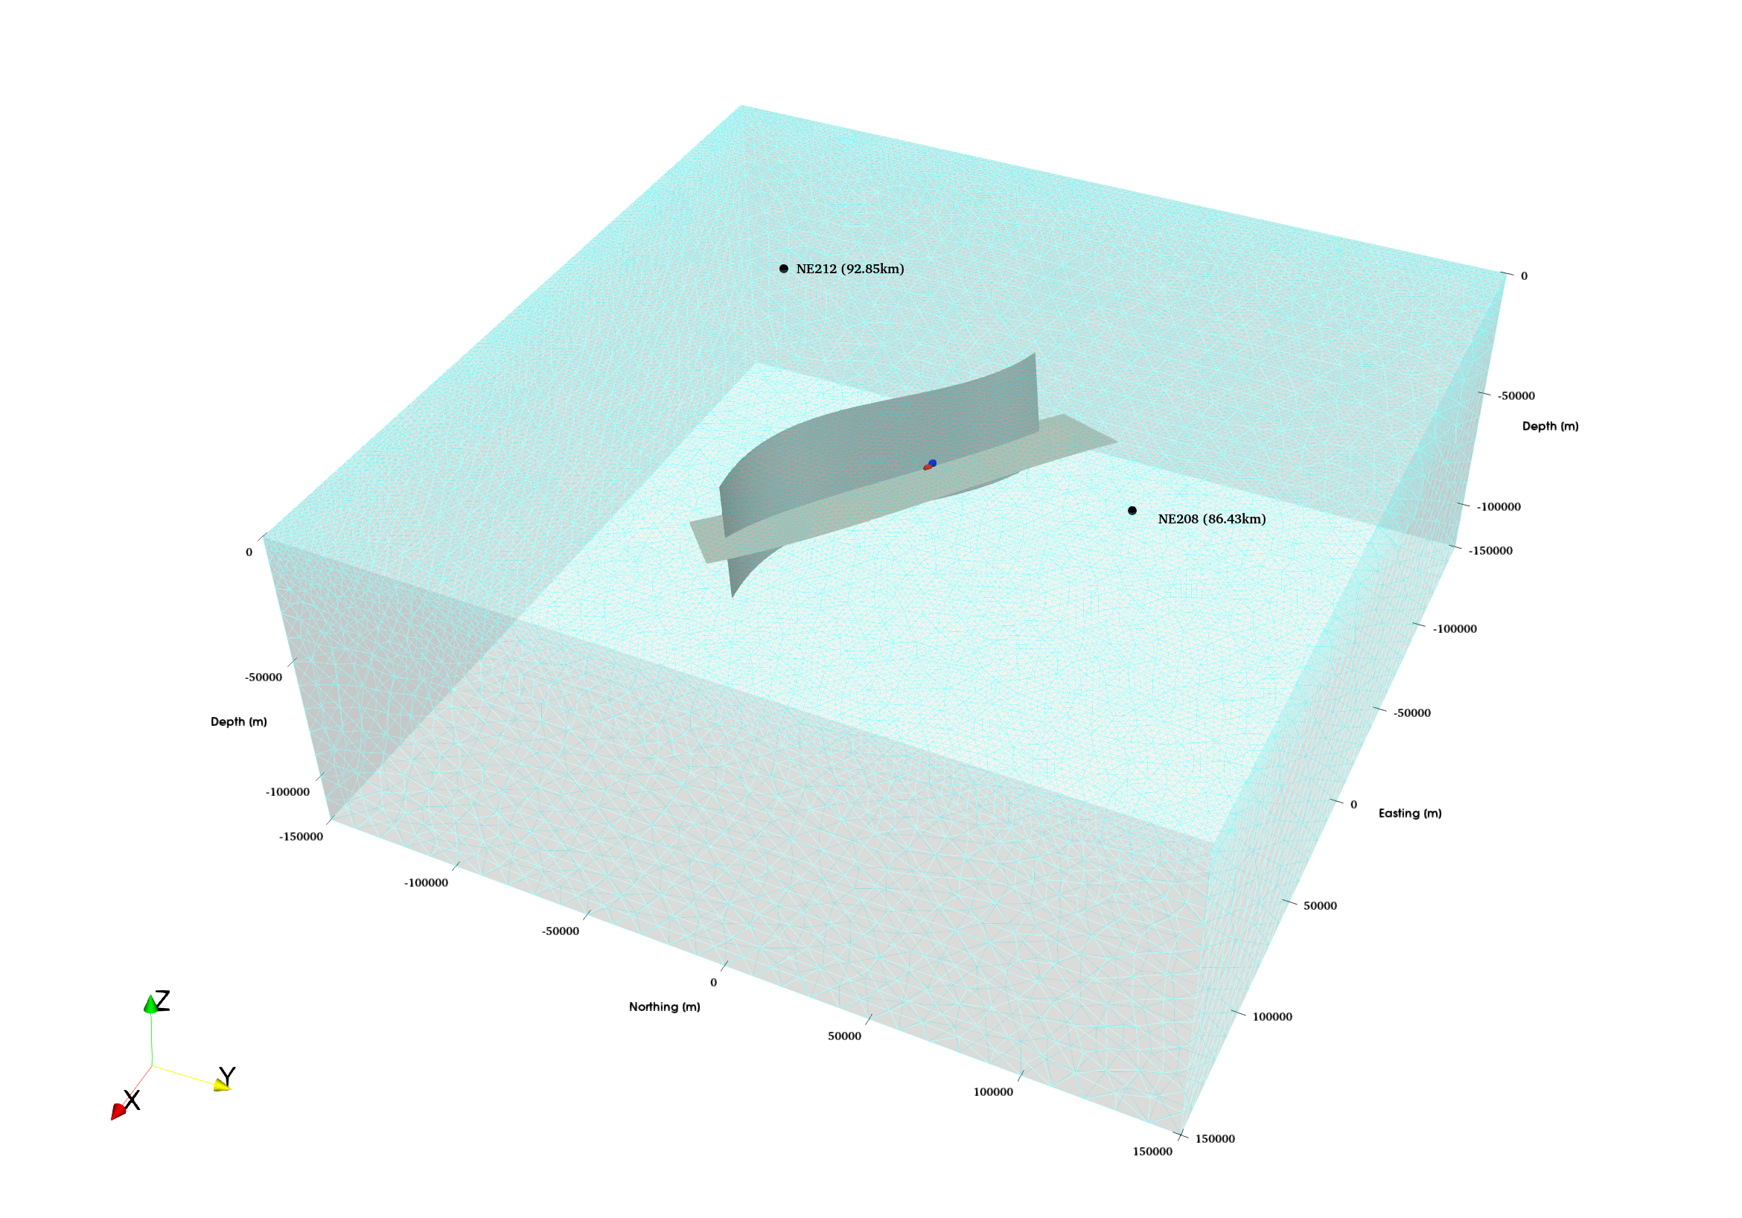
Mesh

Slide 6
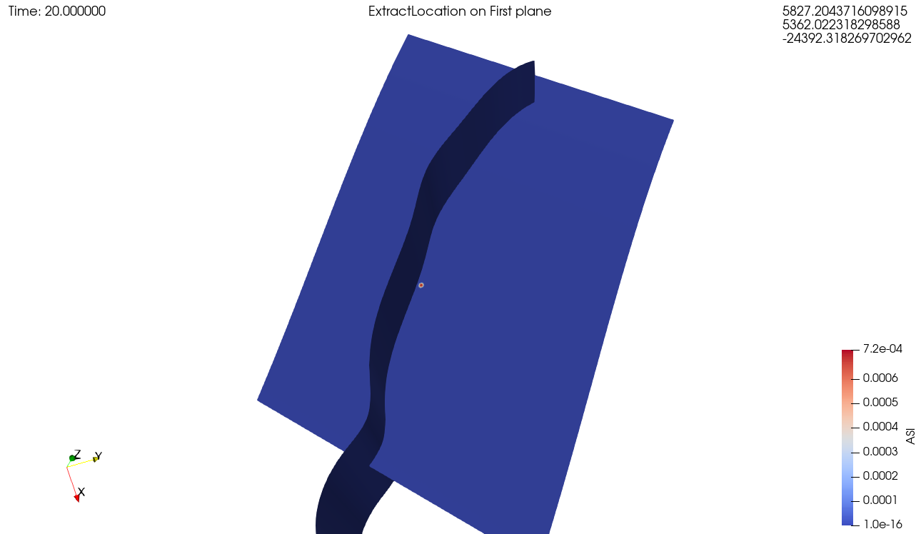
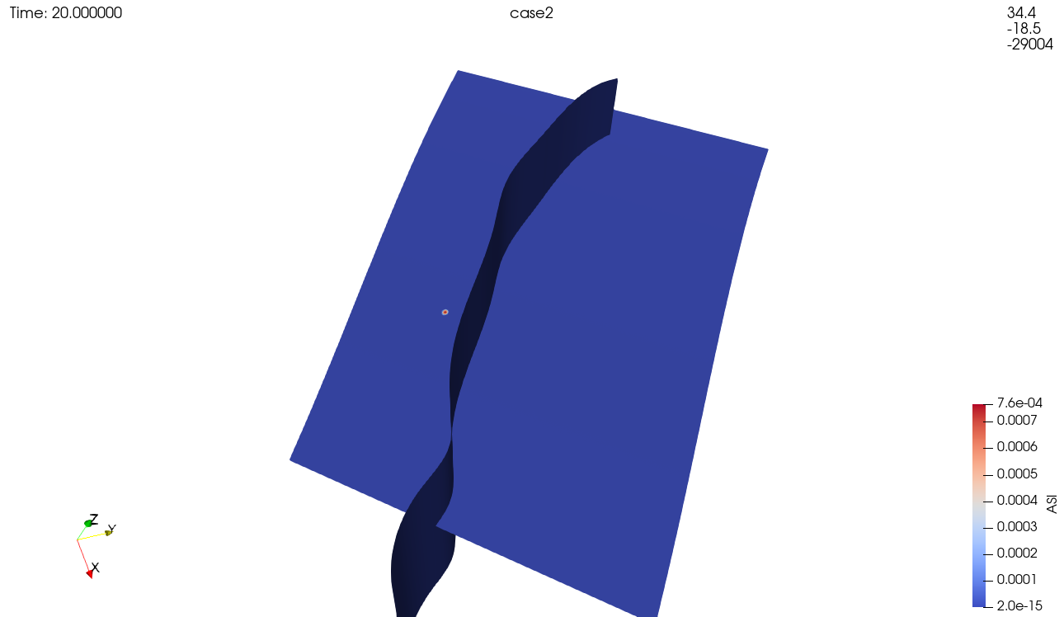
Failed attempts

Slide 7
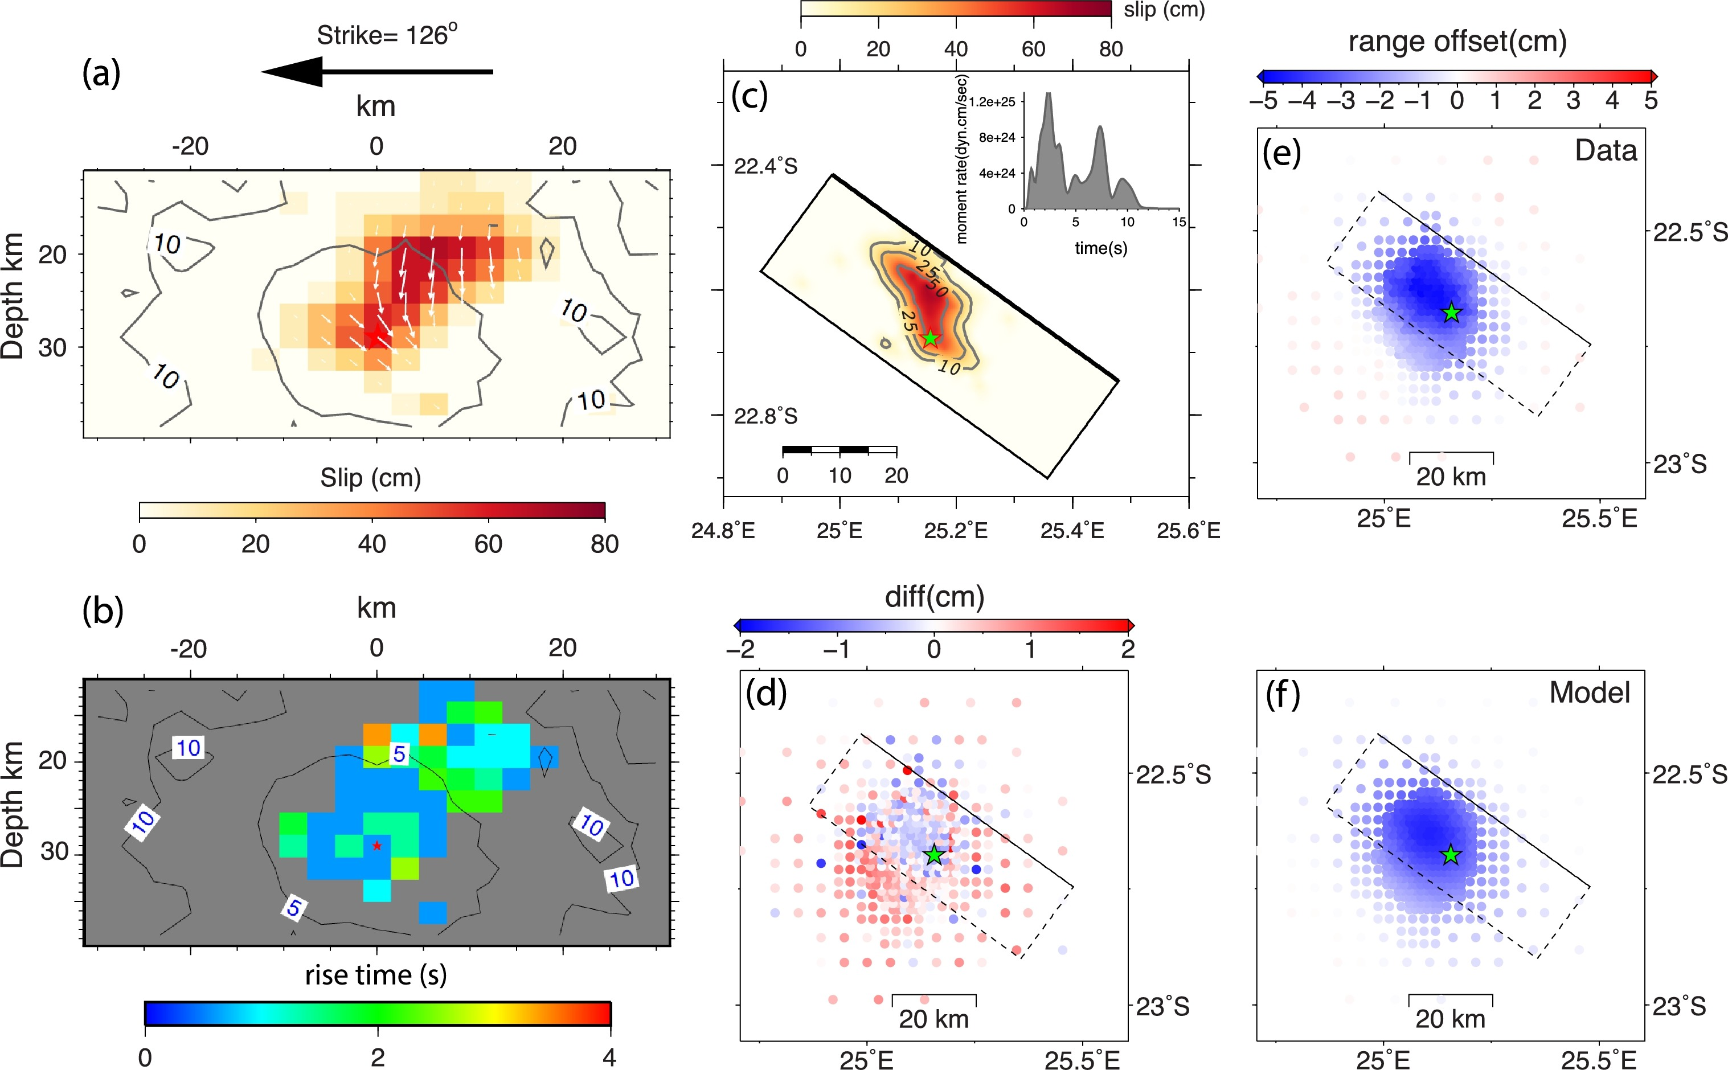
Kenematic model (Shengji wei)

